Slide 1
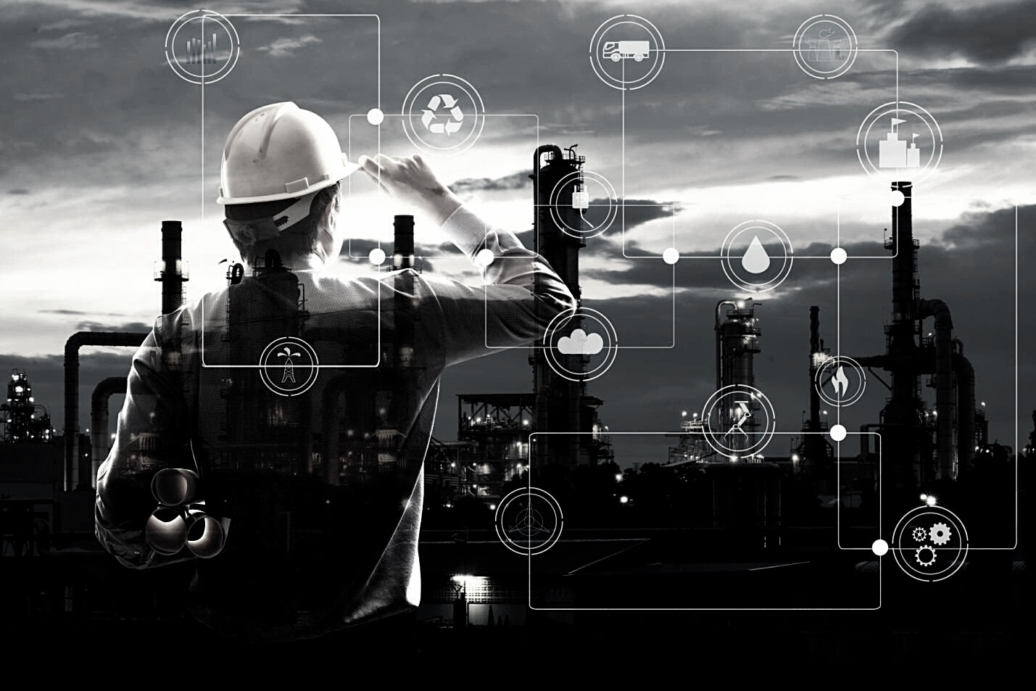
1
SEISMIC FAULT DETECTION USING DEEP LEARNING
Aditya Shah, Ashwini Akula, Avisha Singh, Jake Joiner, Nivedita Shanbhag, Vandan Pandya, Juan Flores

Slide 2
2
Project Outline
Topics to be Covered
Introduction
Objective
Impact and Value
Literature Review
About the data
Workflow
Model training and testing
Results
Conclusion

Slide 3
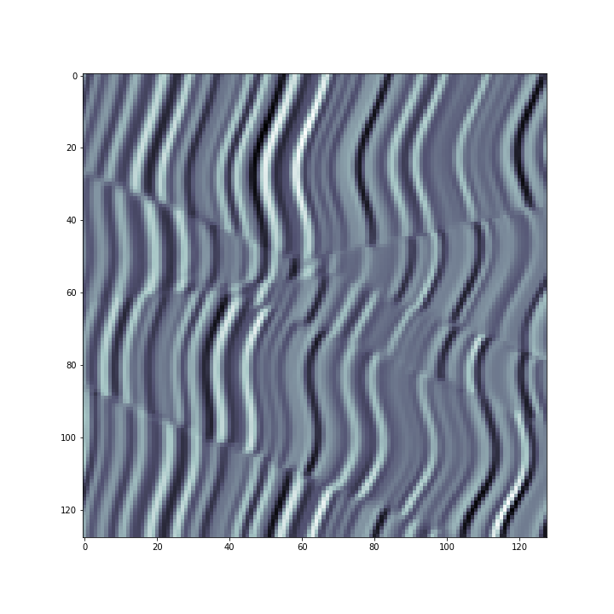
Seismic fault detection uses sound waves to build a picture of what’s under the ground and help us identify faults by looking for discontinuities in the signal.
3
Introduction

Slide 4
4
Traditional approaches used to detect faults were by looking at faults, use image processing, and using domain knowledge to interpret the faults.
Problems:
Operator intensive to study 2D or 3D seismic images.
Strenous for eyes.
Eigen structure coherence, gradient structure tensor have noise, which is sometimes difficult to differentiate.
In order to solve the problem, we are utilizing computer vision techniques.
Introduction

Slide 5
5
The objective is to detect faults in seismic images using deep learning approach of image segmentation.
This project attempts to do a comparative analysis of three such image segmentation techniques: FPN, Unet, and Linknet along with three feature extractors Resnet, Inceptionnet, and VGG16.
Leveraging best performing model, we are detecting faults in form of masked images.
Objective

Slide 6
6
Identifying faults is critical in determining the size of the reservoir, which determines where to drill, what type of well to drill and ultimately the amount of oil recovered from a reservoir.
Currently ML techniques are used to approximate where faults might be and this is used in conjunction with humans checking to confirm this is the case
These humans are expensive
The detection of faults through ML has the potential to reduce both the time and cost of getting the oil out of the ground
Impact and Value

Slide 7
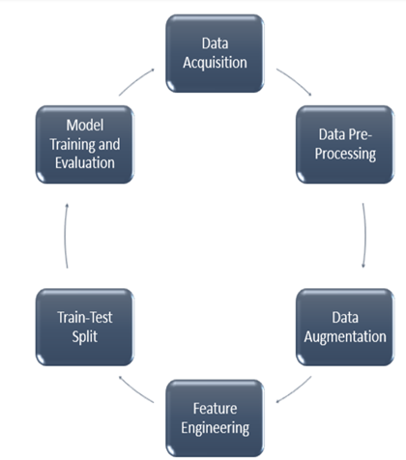
9
Workflow

Slide 8
7
Di, H., Shafiq, M., Wang, Z. et al. 2019. Improving seismic fault detection by super-attribute-based classification.
Araya-Polo, M., Dahlke, T., Frogner, C. et al. 2017. Automated fault detection without seismic processing.
Xiong, W., Ji, X., Ma, Y. et al. 2018. Seismic fault detection with convolutional neural network.
Literature
review

Slide 9
8
A. Pochet, P. H. B. Diniz, H. Lopes and M. Gattass, "Seismic Fault Detection Using Convolutional Neural Networks Trained on Synthetic Poststacked Amplitude Maps,"
Li, Shengrong, Changchun Yang, Hui Sun and Hao Zhang. “Seismic fault detection using an encoder–decoder convolutional neural network with a small training set.”
Zheng, Zhi Hong, et al. “Multi-Attributes and Neural Network-Based Fault Detection in 3D Seismic Interpretation.”
Literature
review

Slide 10
10
The dataset used in our project was the “Netherlands f3 block data”.
Contains different images of synthetic data and segmented data (400 images)
200 - synthetic seismic images
200 - labeled images that clearly depict the faulty seismic data.
xinwucwp/faultSeg: Using synthetic datasets to train an end-to-end CNN for 3D fault segmentation (We are working on an improved version!) (github.com)
About the dataset

Slide 11
11
Data augmentation acts as a regularization to avoid overfitting and add variation into the data.
Performed augmentation techniques such as horizontal and vertical flip on both seismic and masked images
Results - the loss was significantly reduced, and the mean IOU increased as compared to results with 200 images.
Why data augmentation

Slide 12
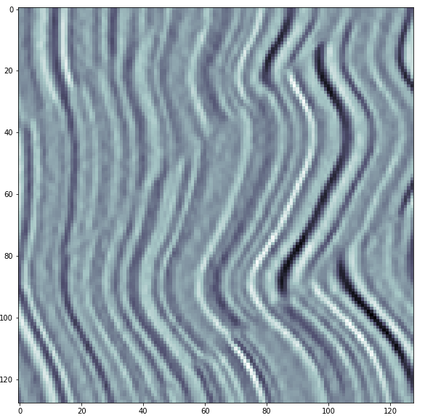
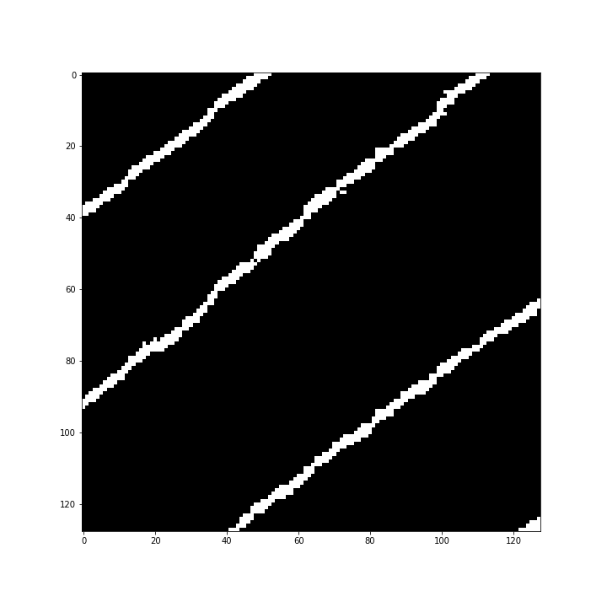
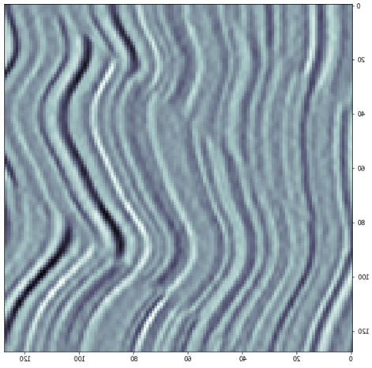
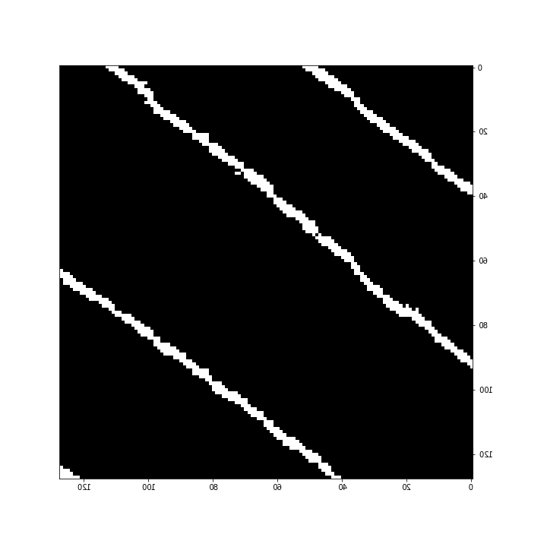
12
Data Augmentation: Horizontal and Vertical flips

Slide 13
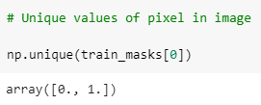
13
Imported seismic images and resized to 128 * 128 pixels
Store all the resized images into a list
Labelling of image is the binarization of an image. We seek to convert a grayscale image to a binary image, where the pixels are either 0 or 255.
Convert the image with pixels 0 or 255 to 0 or 1.
Provides a ground truth information to a model which helps in segmentation.
Data Processing

Slide 14
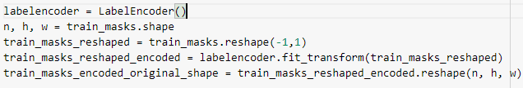
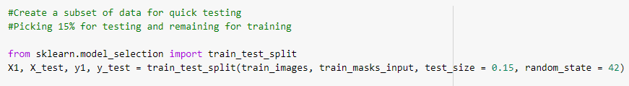
14
Encoding the levels of categorical features into numeric values.
Train test split
Feature engineering

Slide 15
15
Model Training and Testing
Using train data, we trained 3 segmentation models with 3 feature extractors.
In a way, we performed 9 experiments.

Slide 16
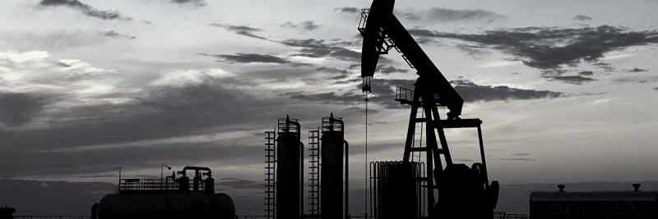
16
SEGMENTATION TECHNIQUES
U-NET
LINK-NET
FPN
Image segmentation is used to classify each pixel value and segment the parts in image.
Each segmentation algorithm follows encoder-decoder architecture, where encoder performs downsampling and decoder performs upsampling.

Slide 17
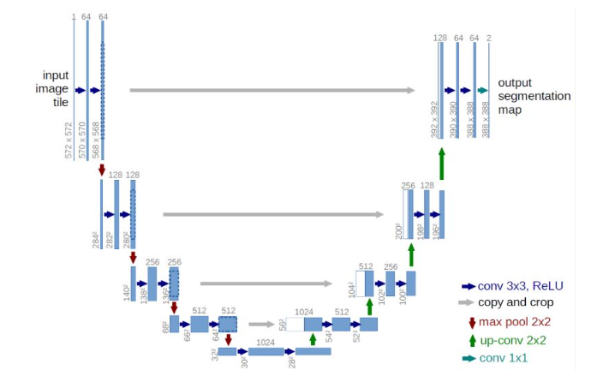
17
U-NET
The encoder is just a traditional stack of convolutional and max pooling layers.
The decoder is used to enable precise localization using transposed convolutions.
It does not contain dense layer and because of which it can accept any size image.

Slide 18
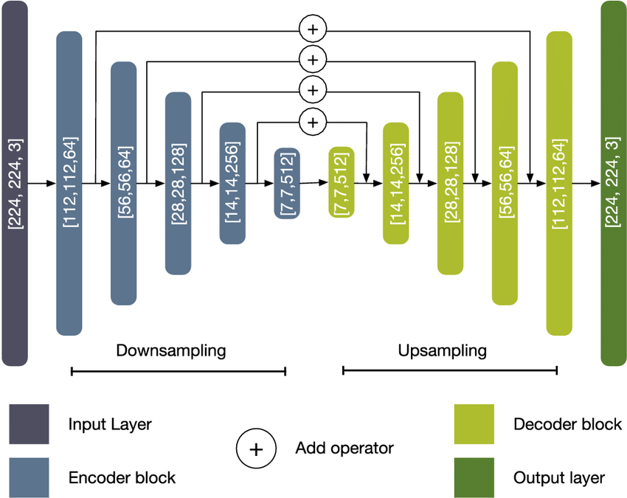
18
LINK-NET
The encoder efficiently share the information learnt by it to decoder. (focuses more on information sharing).
It is better than pooling.
It has few parameters in decoders and due that it is computationally cheap.

Slide 19
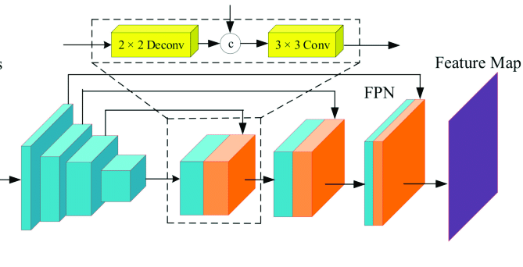
19
FPN
The FPN takes arbitrary size as input and outputs proportionally sized feature maps at multiple levels.
Th bottom up is feedforward computation, which computes a feature hierarchy consisting of feature maps at several scales.
Top-down hallucinates higher resolution features with high semantic value.

Slide 20
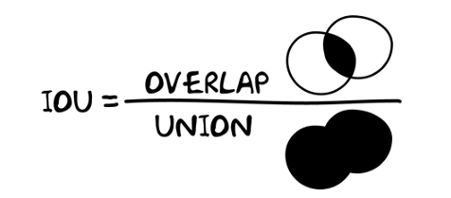
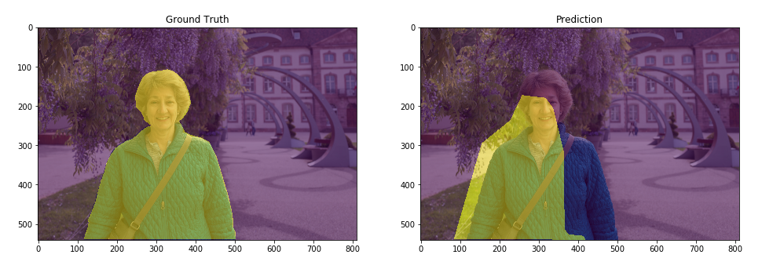
20
IOU (Intersection over Union)
It is also referred to as Jaccard index to evaluate the percent overlap between the target mask and our prediction output.
Closer to one, better the model.

Slide 21
21
FEATURE
EXTRACTORS
RES-NET
INCEPTION-NET
VGG16
Feature extractors used within segmentation algorithms are transfer learning techniques used for image classification task and used as backbone in many computer vision tasks.

Slide 22
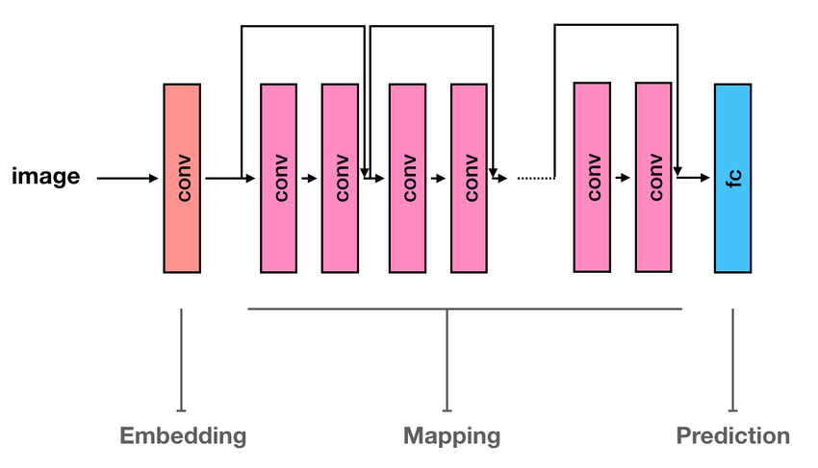
22
RES-NET
It was the first network to be trained with 150+ layers successfully.
The strength of resnet is skip connections as it helps mitigate the problem of vanishing gradient and ensures that higher layers perform better than lower layers.

Slide 23
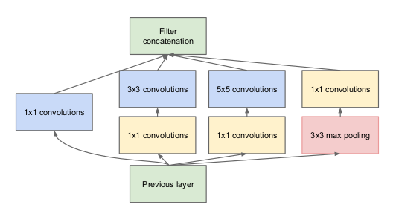
23
INCEPTION-NET
Inceptionet is a sparsely connected network that focuses more on learnings from the previous layer.
It generates multiple features with different kernel size and combines it to learn to make it robust.

Slide 24
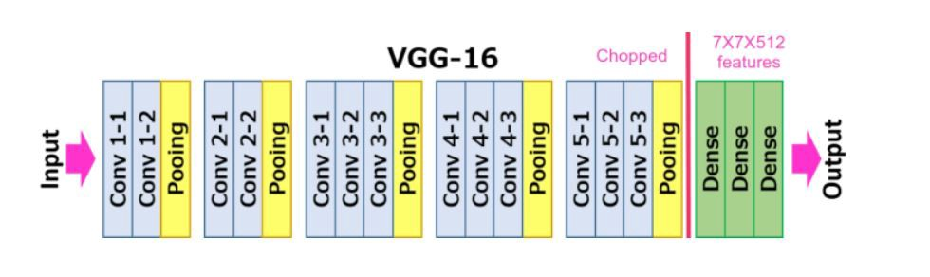
24
VGG16
VGG16 is an architecture with 16 layers consisting convolution, pooling operations and 3 fully connected layers.
Architecture is enhancement of alexnet network with less number of parameters.

Slide 25
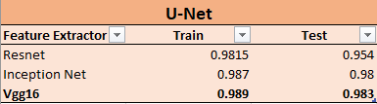
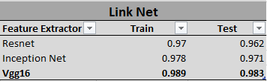
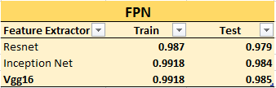
25
RESULTS
U-NET
LINK-NET
FPN

Slide 26
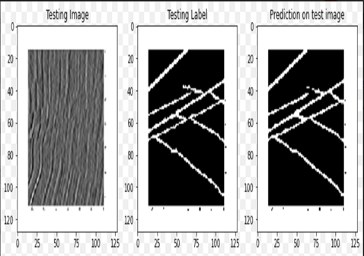
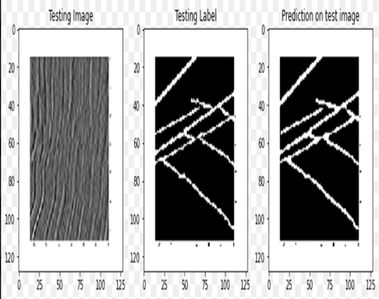

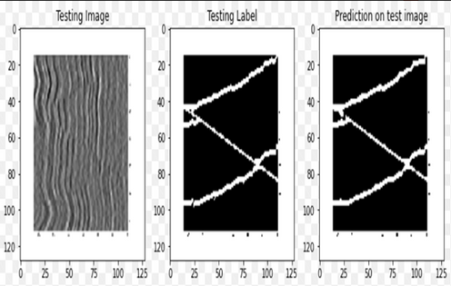
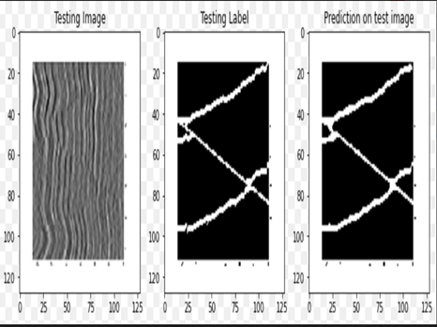
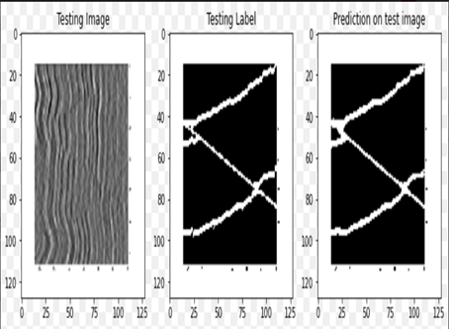
26
LINKNET WITH VGG16(1)
FPN WITH VGG16(1)
UNET WITH VGG16(1)
FPN WITH VGG16(2)
UNET WITH VGG16(2)
LINKNET WITH VGG16(2)

Slide 27
27
Conclusion
The FPN is the best image segmentation technique among all the three as it has the best train and test mean Intersection over the Union score among all the three feature extractors for these dataset.
VGG16 is the best extractor for all the three image segmentation techniques as it has the highest mean Intersection over Union score for all the image segmentation techniques for both the train and test data.

Slide 28
28
Thank You

